Slide 1
Membership Needs in Corona Times – Results Survey
Thursday April 16, 2020

Slide 2
N = 236
Totale aantal reacties/Nombre total de réactions
Aanmaakdatum/Date de création : zondag 22 maart 2020/dimanche le 22 mars 2020

Slide 3
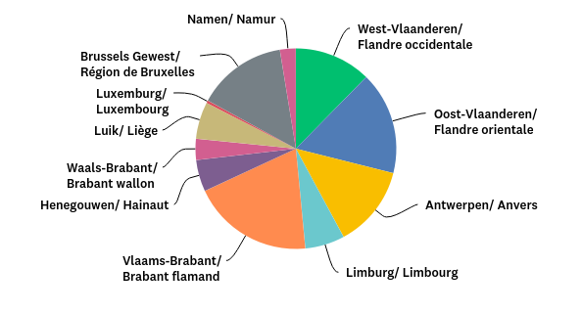
V1: Mijn praktijk ligt in de volgende provincie (of stad)/Mon cabinet est situé dans la province (ou ville) suivante:
Beantwoord: 235 Overgeslagen: 1

Slide 4
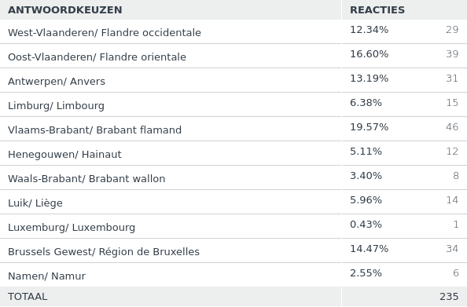
V1: Mijn praktijk ligt in de volgende provincie (of stad)/Mon cabinet est situé dans la province (ou ville) suivante:
Beantwoord: 235 Overgeslagen: 1

Slide 5
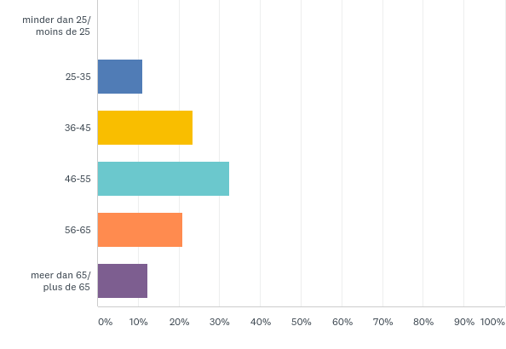
V2: Mijn leeftijd/ mon âge
Beantwoord: 235 Overgeslagen: 1

Slide 6
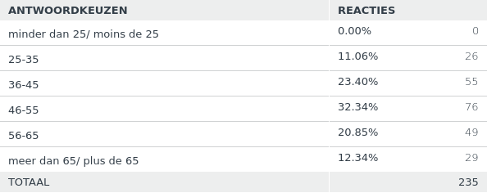
V2: Mijn leeftijd/ mon âge
Beantwoord: 235 Overgeslagen: 1

Slide 7
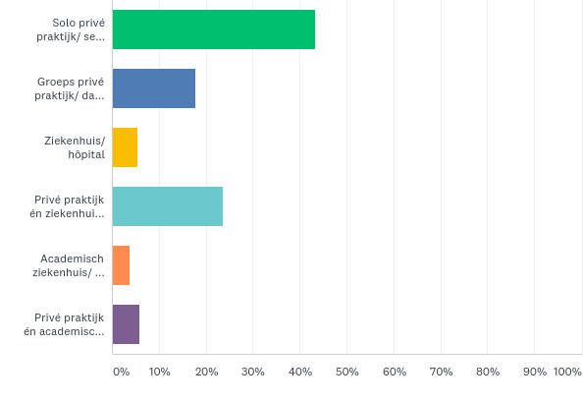
V3: Ik werk in een/ Je travaille dans un
Beantwoord: 236 Overgeslagen: 0

Slide 8
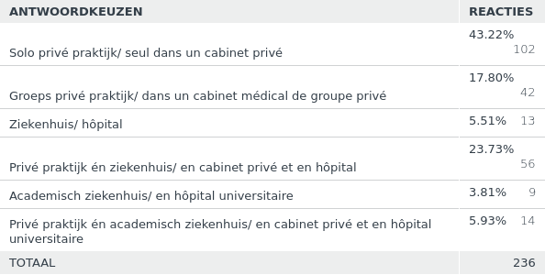
V3: Ik werk in een/ Je travaille dans un
Beantwoord: 236 Overgeslagen: 0

Slide 9
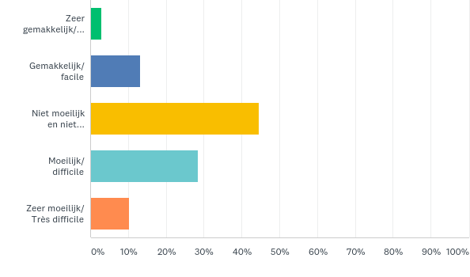
V4: Hoe eenvoudig of moeilijk was het om uw organisatie te wijzigen conform de Corona maatregelen ? Était-il facile ou difficile d’adapter votre organisation aux mesures prises contre le coronavirus ?
Beantwoord: 236 Overgeslagen: 0

Slide 10
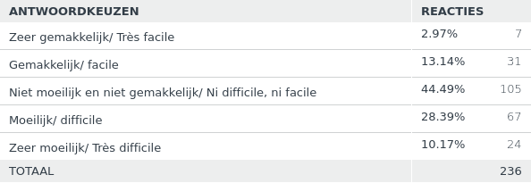
V4: Hoe eenvoudig of moeilijk was het om uw organisatie te wijzigen conform de Corona maatregelen ? Était-il facile ou difficile d’adapter votre organisation aux mesures prises contre le coronavirus ?
Beantwoord: 236 Overgeslagen: 0

Slide 11
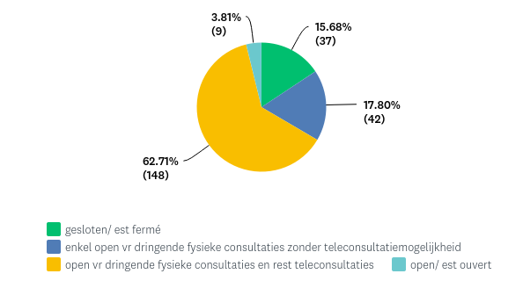
V5: Mijn praktijk is naar aanleiding van de Corona crisis/ Suite à la crise du coronavirus, mon cabinet médical
Beantwoord: 236 Overgeslagen: 0

Slide 12
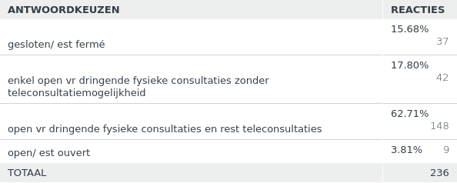
V5: Mijn praktijk is naar aanleiding van de Corona crisis/ Suite à la crise du coronavirus, mon cabinet médical
Beantwoord: 236 Overgeslagen: 0

Slide 13
Frequently Asked Questions : will follow soon on the website
Some answers are already present :
See https://www.belgiandermatology.be/nl/consultation-guidance-in-times-of-corona (Dutch)
See https://www.belgiandermatology.be/fr/consultation-guidance-in-times-of-corona (French)
See https://www.dermanet.be/nl/pro_praktische_info/coronavirus
See https://www.belgiandermatology.be/nl/announcements/position-statement-immonusuppressants (Dutch)
See https://www.belgiandermatology.be/fr/announcements/position-statement-immonusuppressants (French)
Other interesting link :
https://www.eadv.org/covid-19

Slide 14
Additional statement on the use of immunosuppressants from the “Skin Inflammation and Psoriasis International Network” (https://www.spindermatology.org/)
“The available data on past and present outbreaks of Coronavirus infections (SARS, MERS, COVID-19) suggest that immunosuppressed patients are not at increased risk for severe manifestations and complications of COVID-19 compared to the general population.
Immunosuppressive and immunomodulatory drugs (human interleukin-1 receptor antagonist and anti-interleukin-6) may potentially control the “cytokine storm” associated with a poorer outcome in these patients.
Thus, patients with cutaneous immune-mediated diseases (including psoriasis, atopic dermatitis, and hidradenitis suppurativa) can in general (and subject to individual consideration with the prescriber) continue their treatment even during the COVID-19 outbreak. This would prevent disease flares that can contribute to increasing patient burden, disability, poor quality of life, and healthcare usage.
It is generally recommended to withhold immunosuppressive (e.g. methotrexate, cyclosporine) or biologic treatment in patients with active COVID-19 infection. Starting these treatments in the event of active infections is contraindicated.
If patients develop symptoms consistent with COVID-19 infection, it is advisable that such treatments are paused. We recognize that some comorbidities associated with psoriasis, hidradenitis suppurativa and atopic dermatitis (obesity, diabetes, hypertension, cardiovascular disease, chronic lung disease, asthma) and age older than 60 worsen the prognosis of COVID-19 infection.
If patients live in areas with a high incidence of COVID-19 infection or are close contacts of confirmed cases, individual consideration should be given to temporary treatment discontinuation of some therapies considering factors such as age or comorbidities.
We do not currently have data regarding the impact of systemic psoriasis therapies (or therapies for atopic dermatitis and hidradenitis suppurativa) on susceptibility to or severity of COVID-19 infection. Thus, any guidance is based on previous clinical experience and an understanding of the mechanisms of action of our therapies. We recommend that all patients with these diseases who have either suspected or confirmed COVID-19 infection are entered into the relevant registries established to address this lack of data.”

